Slide 1
Citroën AMI (A/B) – Internal disruption in the automotive industry
Jan Lepoutre
8/12/2022

Slide 2
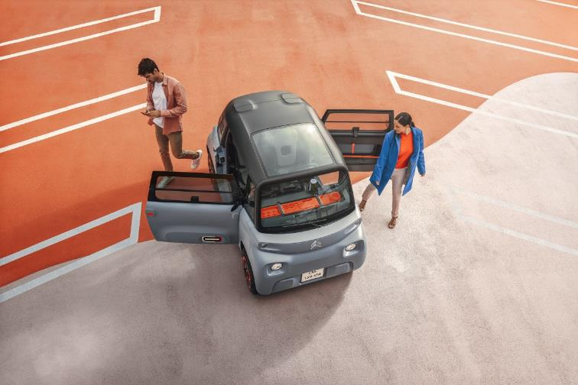
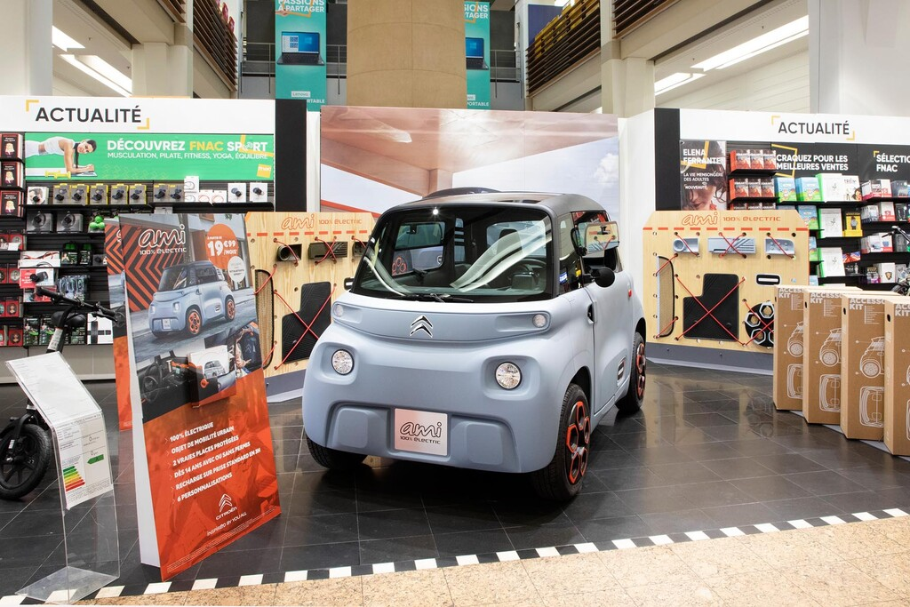
Introducing … Citroen AMI
A unique “vehicle”: not a car, a quadricycle (L6)
L6: drivable from 14y old onwards in France
Cheap: 7k euro vs market average 12k (L6/L7)
Unique design
Electric: 75km autonomy
Tubular chassis with plastic panels
Asymmetrically opening doors
Low tech
Two seater
Unique sales strategy
Display online, brand distribution network and electronics retailer
D2C online purchasing only, D2C delivery
…but the true innovation lies elsewhere

Slide 3
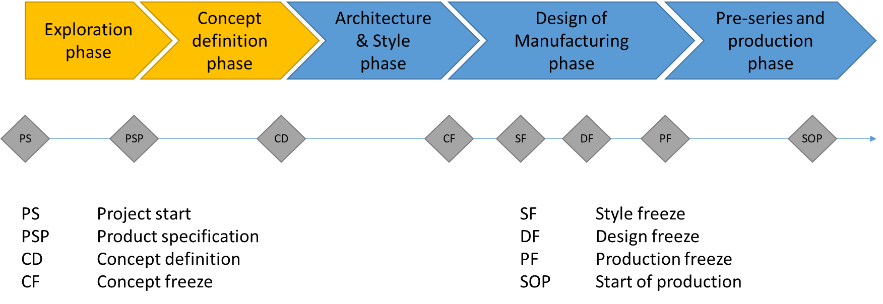
The automotive industry in 2017: genesis of a vehicle
Typical development cycle of vehicles = 4-6 years, total vehicle and parts lifecycle = 15 years
Total project fixed cost = 500M-1B euro, depending on mutualized parts and existing factories
Modularization into “platforms” to recycle parts and components across vehicles and vehicle generations
Stage-gate development process to manage interdependent choices and downstream risks in output
New cars replace or update existing ones in the brand portfolio

Slide 4
The automotive industry in 2017: commercialization of a vehicle
Automotive industry = B2B
Brand marketing, advertising and communication managed by brands
Distribution and sales to customers
Brand owned dealerships
Independent dealerships
Digital platforms
Customer journey shifting from dealership centred to a combination of online search, testing and transaction in dealership
Transactions
Sale
Long term leasing
Short term rental

Slide 5
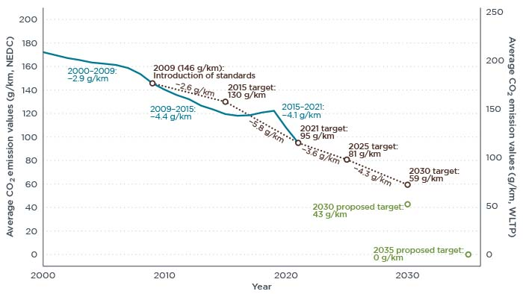
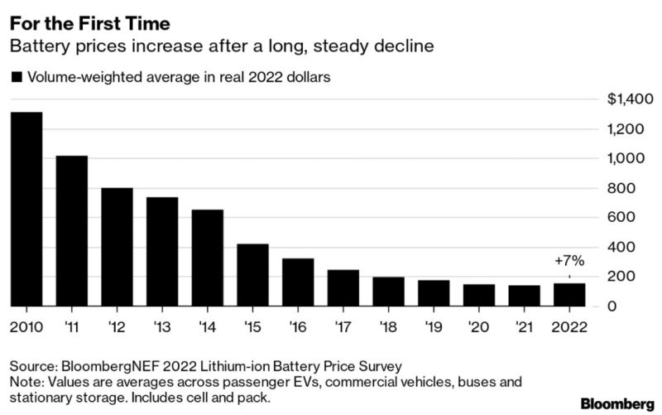
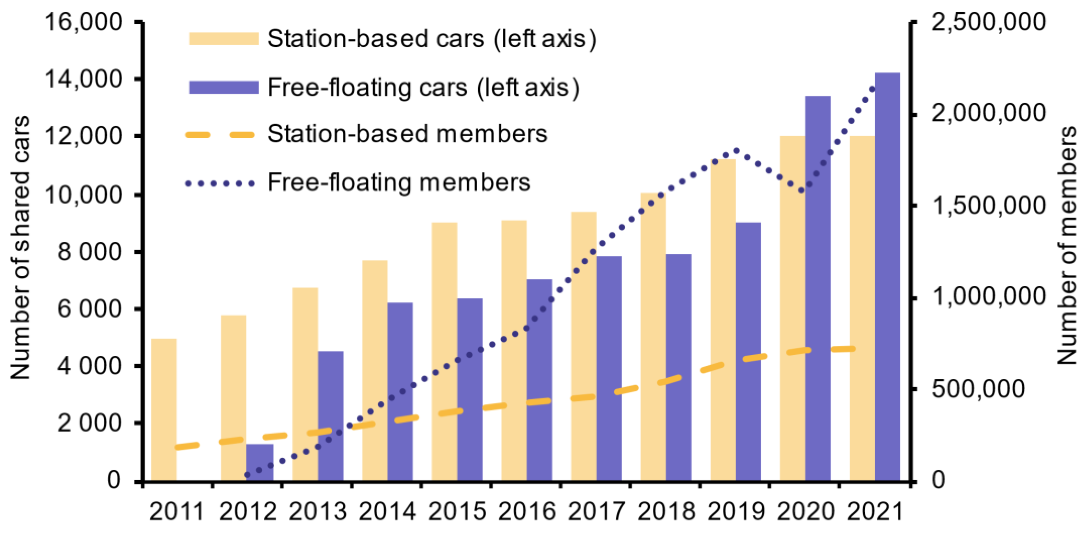
The automotive industry in 2017: CASE
Significant changes in the industrial and market environment of the automotive industry
New technologies and usages: Connected, Autonomous, Shared, Electric?
Technological developments, regulatory changes and customer behaviours change at speeds that exceed adjustment speeds of factory and tooling amortization

Slide 6
How can we increase the automotive industry’s clockspeed?

Slide 7
Methodology
Process study (Van de Ven, 1992; Langley et al., 2013)
Objective: create timeline of events that explain the changing phenomenon
Archival data collected between March 2020 and July 2022
Press releases
Social media posts
Product reviews
TV or media interviews with product / brand team
Interviews collected between February 2021 and July 2022
13 interviews with 14 people
R&D and engineering
Citroen brand team
Program management

Slide 8
The AMI product brief
By Carlos Tavares to DRIA division
Four-wheel mobility object, designed for ultra-urban mobility
Classified as an L6 (light quadricycle, drivable without a driver’s license and a maximum speed of 45 km/h)
Look very different from competing offers.
Vehicle was to be electric, but with a maximum autonomy of 100km.
Production cost as little as possible, a truly accessible car that could be a true substitute for other forms of urban mobility.
Project needed to be realized in less than 3 years.
Brand-agnostic
High level of secrecy

Slide 9
The genesis of the Citroen AMI
Normal: 4-5 years
Program division and Brand decide on new vehicle specifications
Brand + Engineering divisions, coordinated by program manager work towards an Advanced project
Integration in product planning
Style is fixed
Tooling is engaged
Upon completion, vehicle is handed back to brands for branding and sales
AMI: 2,5 years
Initiated by Carlos Tavares in early 2017
Engineering division, together with external partner Gruau deliver Advanced project
Given to Citroen brand, in coordination with external partner Altran-Magna-Steyer
Manufacturing to be done in new Kenitra factory (Morocco)
First deliveries May 2020
Tensions
Outside of any process, but stage gates were maintained
Increased rhythm required a multidisciplinary “steering committee” to hold managers responsible for contributing to its success. “Carlos Tavares wants this” was an important argument

Slide 10
The advantages of L6 as a petri-dish
L6 is not a car, does not have the same safety and quality test requirements as cars
If you want to see how fast you can go ➔ regulatory barriers removed
L6 is outside of PSA’s existing offering and customer base
Reputational and market risk limited
No problem selling outside of dealership channels

Slide 11
The sales and distribution of the Citroen AMI
Target customers don’t go to Citroen dealership
Deal with FNAC/Darty = most important salespoint for mobility objects
Tensions with dealerships, who also want the vehicle on display
Fully online sales vs. no experience in vehicle selling, invoicing, delivering…

Slide 12
Learnings and benefits: AMI as a sandbox
Vehicle manufacturing: not so much > time compression was artificial
However, put into question which stages / information remains critical even when no limitations
Multidisciplinary steering committee has benefits for achieving tight deadlines
Sales
Distribution network remains important in the customer journey
Online sales capability and experience
Online community experience and management
Sales ambassadors community
L6 is not just for urban users > much higher adoption than expected in peri-urban and even rural communities

Slide 13
Discussion
In the 20th century, radical innovations in the automotive industry were not technological, but organizational
Conveyer belt (Ford)
Multidivisional firm (GM)
Lean manufacturing (Toyota)
Modularity and platforms (all)
The automotive industry knows how to engage in prototyping, hypothesis testing and incremental learning for its product, but it has a hard time doing this organizationally, given the high risks and interdependence of product cycles
Organizational experiments are needed to make the organization adjust to ever faster technological and market challenges
Products that are outside platforms and existing product line-up, but that allow testing them by integrating them in the process
Outside core markets to limit risk of failure

Slide 14
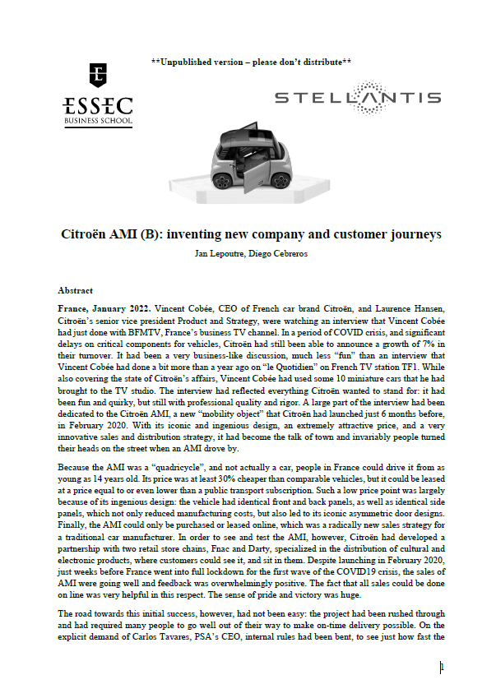
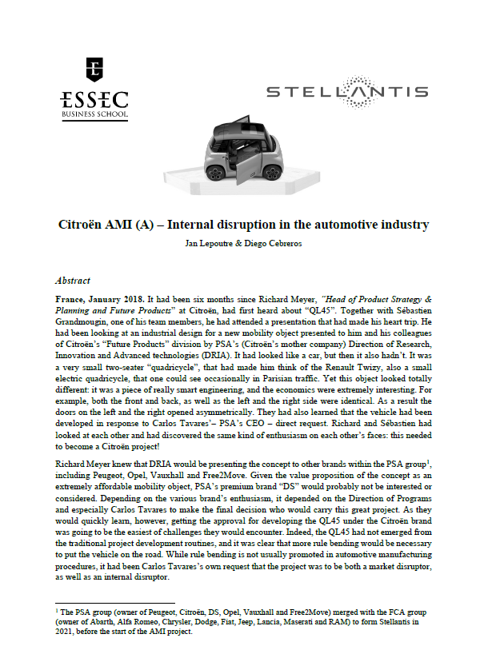
A bit of background
A two-case teaching case to understand and discuss
The genesis of cars (A) and their commercialization (B)
Careers in the automotive industry
Challenges in the automotive industry
Disruption and innovation within the automotive industry
Describing the “normal” by showing deviation from the normal

